Slide 1



Username
Password
LOGIN
SIGN UP

Slide 2
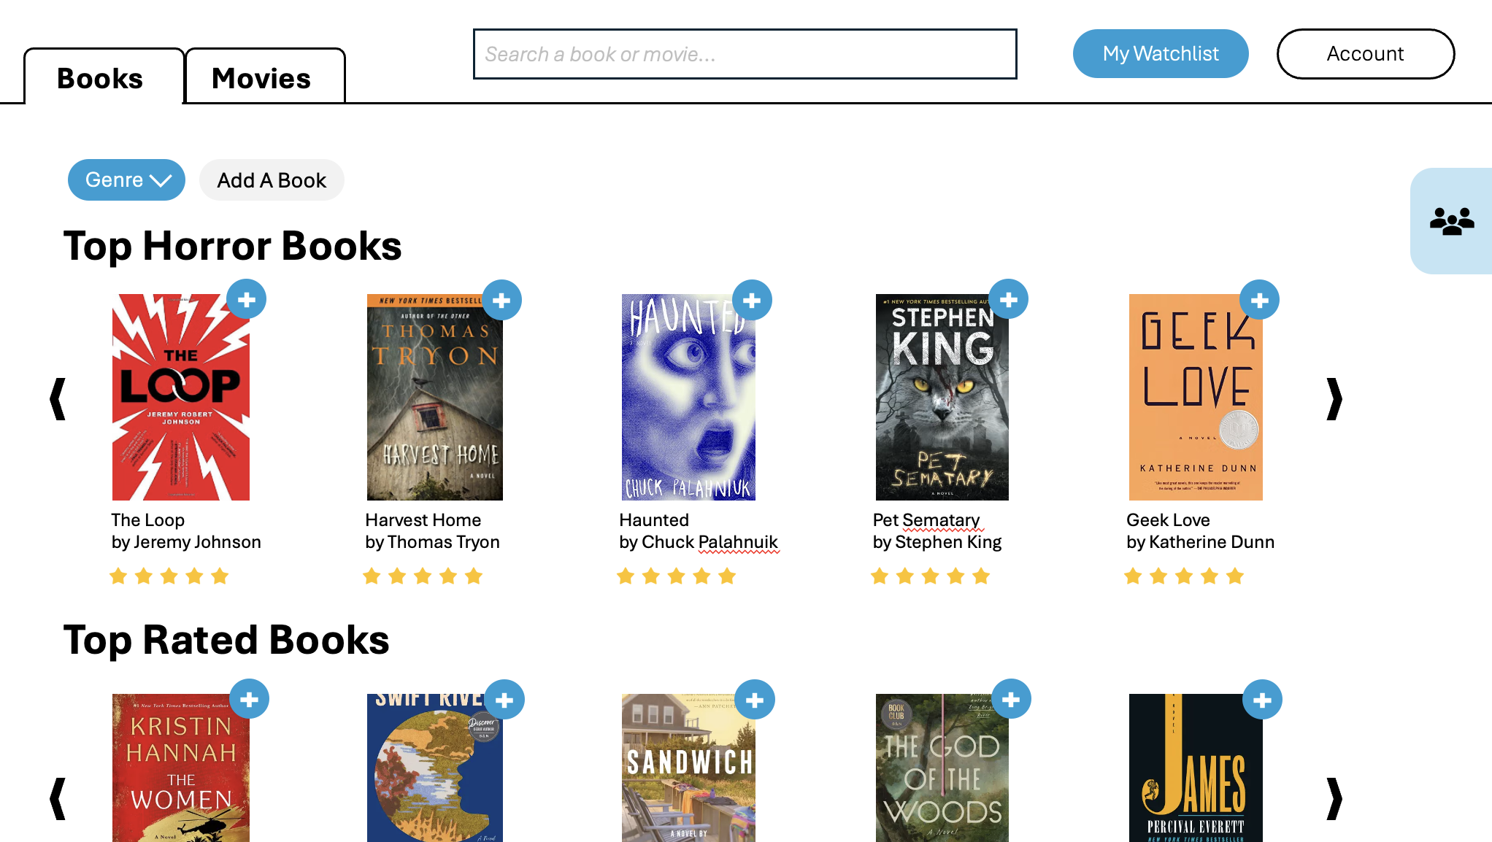
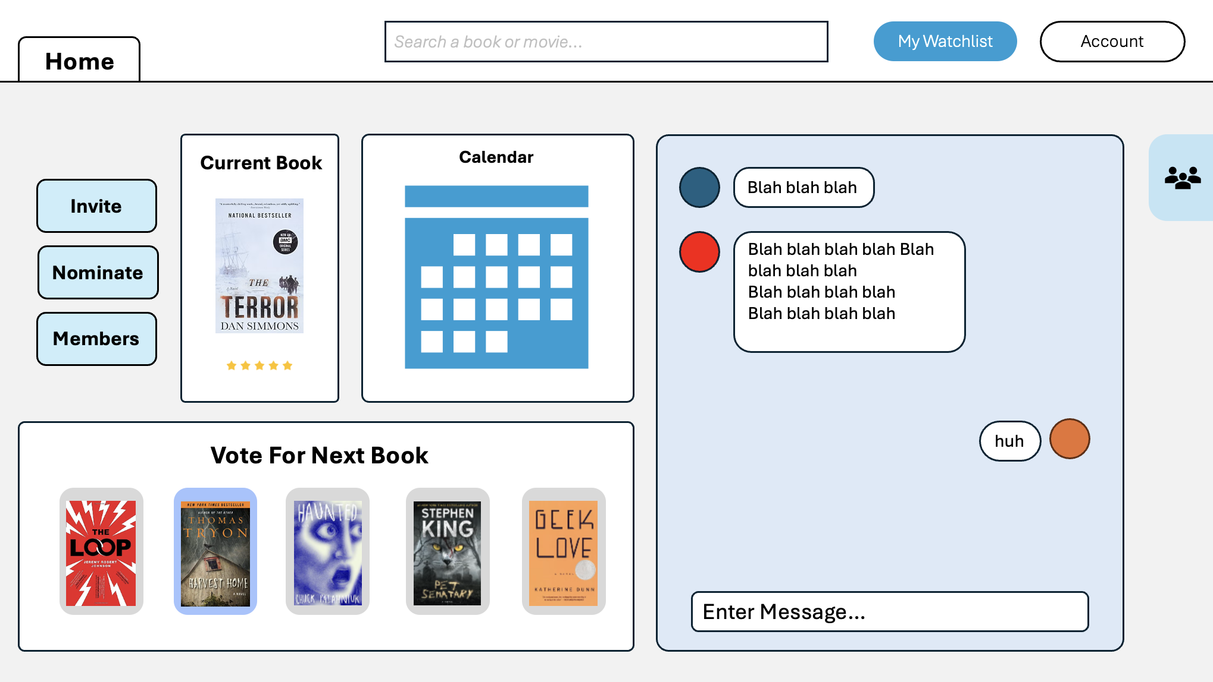

Sign Up
insert something interesting
First Name
Last Name
Username
Password
insert another interesting thing
Repeat Password
Sign Up
Sign in

Slide 3
What Genres Do You Like?
Horror
Adventure
Comedy
Fantasy
Nonfiction
Sci-Fi
Thriller
Mystery
Romance

Slide 4
Join or Create Group?
Join
Create

Slide 5
Enter Group Code
C34JAL1
Random

Slide 6
Create a Group
Name
weluvreading
Type
Books
Movies
Create

Slide 7













Search a book or movie…
My Watchlist
Account
Books
Movies
Genre
Add A Book
Top Horror Books
The Loop
by Jeremy Johnson
Harvest Home
by Thomas Tryon
Haunted
by Chuck Palahnuik
Pet Sematary
by Stephen King
Geek Love
by Katherine Dunn
Top Rated Books

Slide 8

Search a book or movie…
My Watchlist
Account
Books
Movies
Genre
Add A Book
Top Horror Books
My Groups
i<3reading
movies4lyfe
The Loop
by Jeremy Johnson
Harvest Home
by Thomas Tryon
Haunted
by Chuck Palahnuik
Pet Sematary
by Stephen King
Geek Love
by Katherine Dunn
WeBeReading
Top Rated Books
Join
Add

Slide 9
Search a book or movie…
My Watchlist
Account
Books
Movies
Genre
Add A Book
Top Horror Books
My Groups
Enter Group Code
The Loop
by Jeremy Johnson
Harvest Home
by Thomas Tryon
Haunted
by Chuck Palahnuik
Pet Sematary
by Stephen King
Geek Love
by Katherine Dunn
C34JAL1
Top Rated Books
Random

Slide 10
Search a book or movie…
My Watchlist
Account
Books
Movies
Genre
Add A Book
Top Horror Books
My Groups
Name
weluvreading
Type
The Loop
by Jeremy Johnson
Harvest Home
by Thomas Tryon
Haunted
by Chuck Palahnuik
Pet Sematary
by Stephen King
Geek Love
by Katherine Dunn
Books
Movies
Top Rated Books
Create

Slide 11





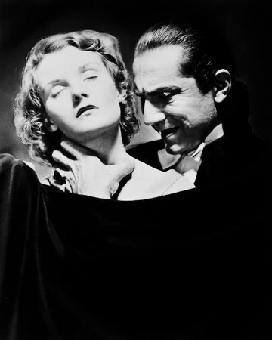




Search a book or movie…
My Watchlist
Account
Books
Movies
Genre
Add A Book
Top Horror Movies
The Exorcist
Halloween
The Thing
I Forget
IT
Top Rated Movies

Slide 12
Search a book or movie…
My Watchlist
Account
Books
Movies
Genre
Add A Book
Top Horror Movies
My Groups
i<3reading
movies4lyfe
The Exorcist
Halloween
The Thing
I Forget
IT
WeBeReading
Top Rated Movies
Join
Add

Slide 13
Search a book or movie…
My Watchlist
Account
Books
Movies
Genre
Add A Book
Top Horror Movies
My Groups
Enter Group Code
The Exorcist
Halloween
The Thing
I Forget
C34JAL1
IT
Top Rated Movies
Random

Slide 14
Search a book or movie…
My Watchlist
Account
Books
Movies
Genre
Add A Book
Top Horror Movies
My Groups
Name
weluvreading
Type
The Exorcist
Halloween
The Thing
I Forget
Books
Movies
IT
Top Rated Movies
Create

Slide 15





Search a book or movie…
My Watchlist
Account
Home
Current Book
Calendar
Invite
Blah blah blah
Blah blah blah blah Blah blah blah blah
Blah blah blah blah
Blah blah blah blah
Nominate
Members
huh
Vote For Next Book
Enter Message…

Slide 16
Search a book or movie…
My Watchlist
Account
Home
Current Book
Calendar
Blah blah blah
My Groups
Invite
Blah blah blah blah Blah blah blah blah
Blah blah blah blah
Blah blah blah blah
Nominate
i<3reading
Members
movies4lyfe
huh
WeBeReading
Vote For Next Book
Join
Add
Enter Message…

